Slide 1


B.M.S COLLEGE OF ENGINEERING,BENGALURU
AUTONOMOUS INSTITUTE,AFFILIATED TO VTU
STUDENT DETAILS PORTAL
NIKHIL S N[1BM19CS102]
NITISH KUMAR M[1BM19CS107]
P PREM SAI[1BM19CS109]
HARSHA V N[1BM20CS406]
UNDER THE GUIDANCE OF:
DR. PALLAVI G B
ASSISTANT PROFESSOR
BMSCE

Slide 2

1.ABSTACT
2.MOTIVATION
3.DESIGN
4.TOOLS USED
5.IMPLEMENTATION
6.OUTPUT SCREENSHOTS
7.CONCLUSION
8.FUTURE ENHANCEMENT
9.REFERENCES
CONTENTS

Slide 3

ABSTRACT:
*This project is done with the html, css , javascript and bootstrap for the frontend design and we used nodejs and mysql for backend.
*This project helps us to collect student details who are already registered through any mode of admissions like kcet , comedk or management.
*In recent years, Because of the pandemic like covid-19 our form is helpful for collecting students’ detail from their home only.
*student can easily fill this form and this form is also helpful for college admission team to easily get the students who are registered and their details can be viewed and updated.

Slide 4
MOTIVATION:
*We have created this form especially for the students who are facing the problem to visit the college to get the admission and to provide their details to the college.
*We are motivated to do this because now the situation is too bad and critical as we are facing covid-19 pandemic.
*because of this pandemic, new students who are about to join the college are not able to visit the college.
*This portal helps these students to fill their details such as academic, personal and family .

Slide 5
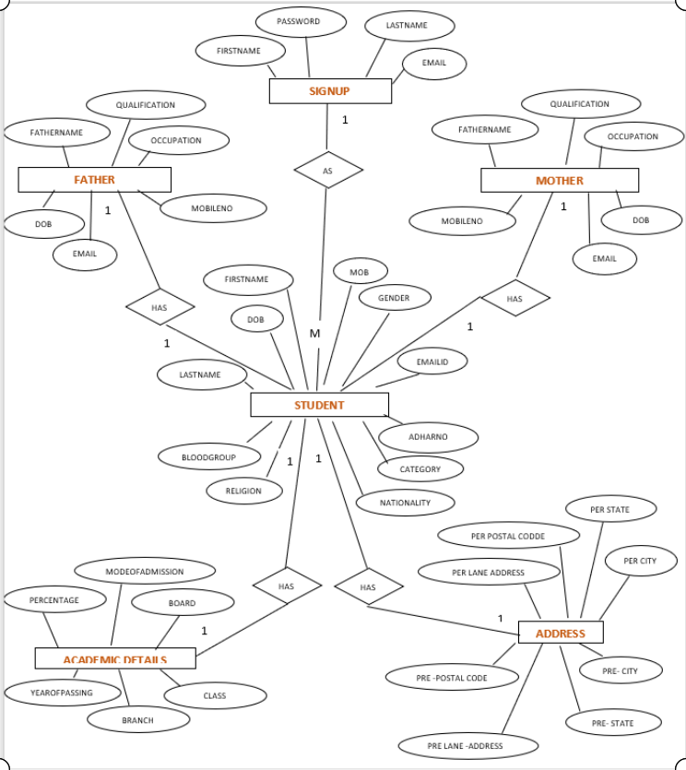
DESIGN
E-R DIAGRAM

Slide 6
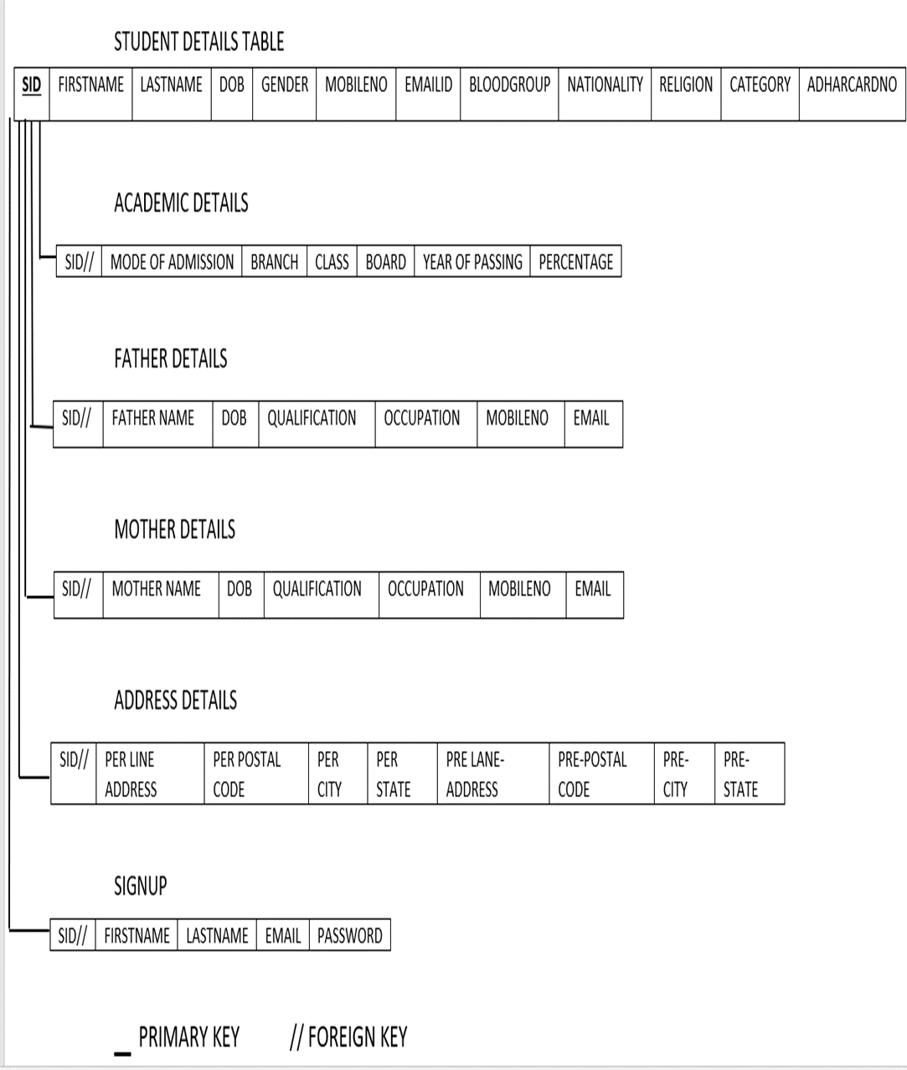
RELATIONAL SCHEMA:

Slide 7
TOOLS USED:
1. Hardware Requirements:
A PC with the following or greater specifications:
Intel Core i3 or higher
4 GB RAM
128 GB Hard Drive and higher
A stable internet connection (2Mbps or higher)

Slide 8
2. Software Requirements:
Operating system : Windows, Linux, MAC
Front end technologies are : HTML, CSS, JAVASCRIPT ,BOOTSTRAP
IDE : VS Code, ATOM
Back end requirement : NODEJS, MYSQL
Server : XAMPP server

Slide 9
IMPLEMENTATION:
1.This project is implemented using html, css, javascript and bootstrap for the front end.
2.We have used vs code and atom IDEs.
3.For the backend, we used nodejs and mysql.

Slide 10
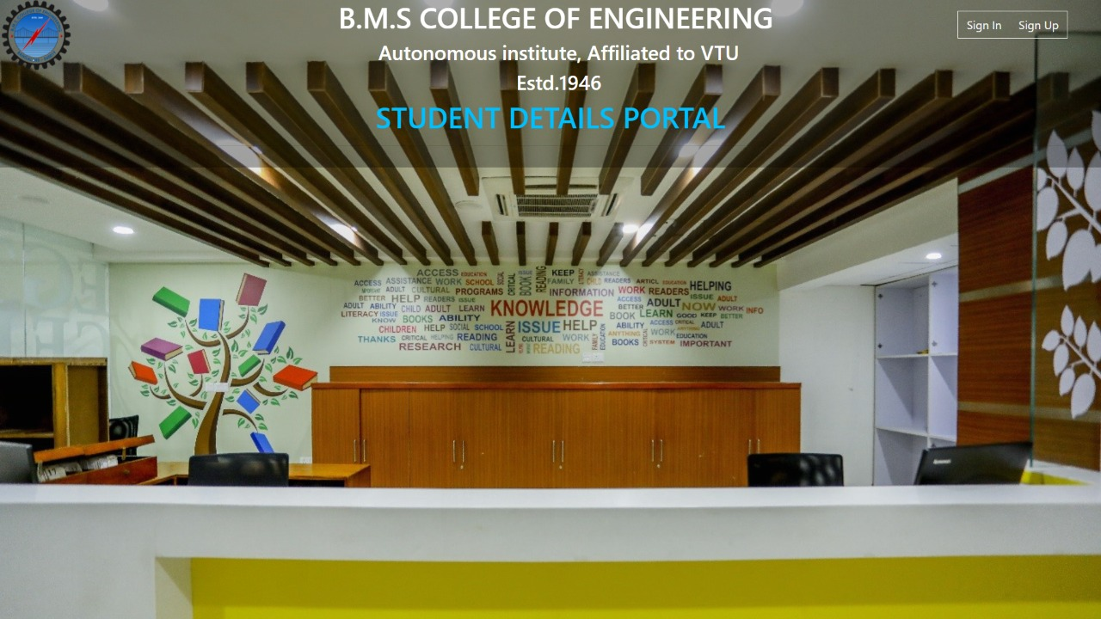
OUTPUT SCREENSHOTS:

Slide 11
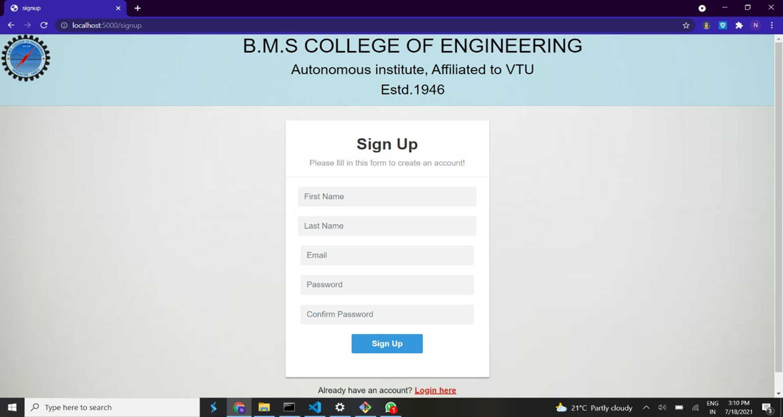
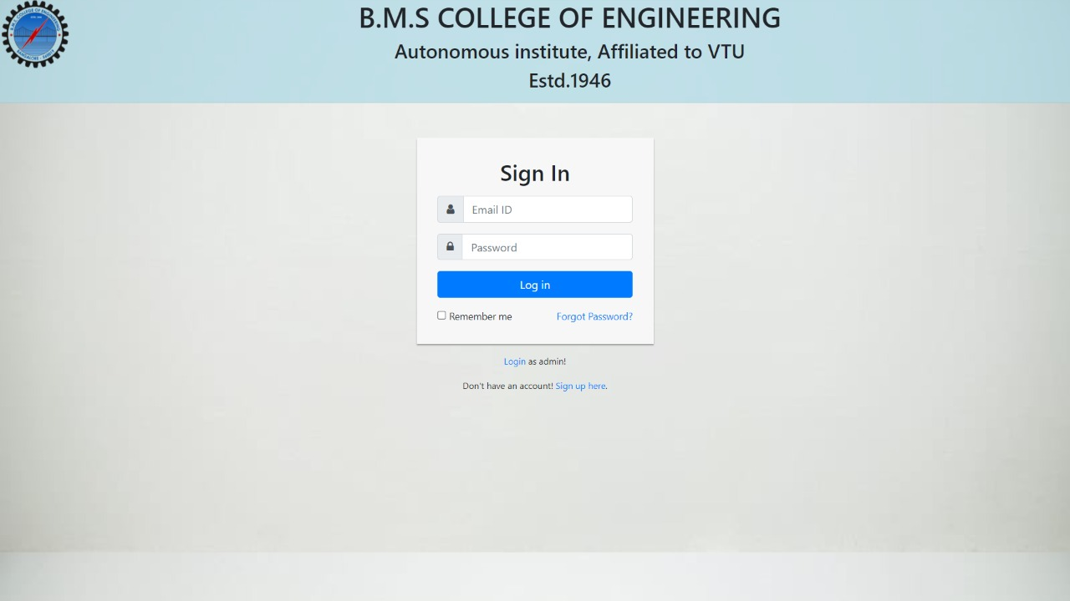
SIGNUP PAGE:

Slide 12

STUDENT SIGNIN PAGE:

Slide 13
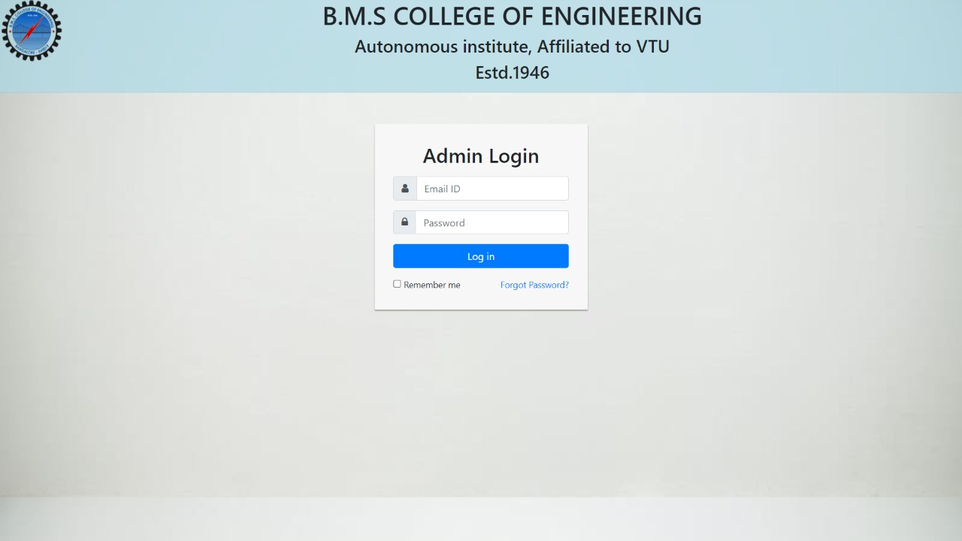
ADMIN LOGIN PAGE:

Slide 14

HOME PAGE-

Slide 15
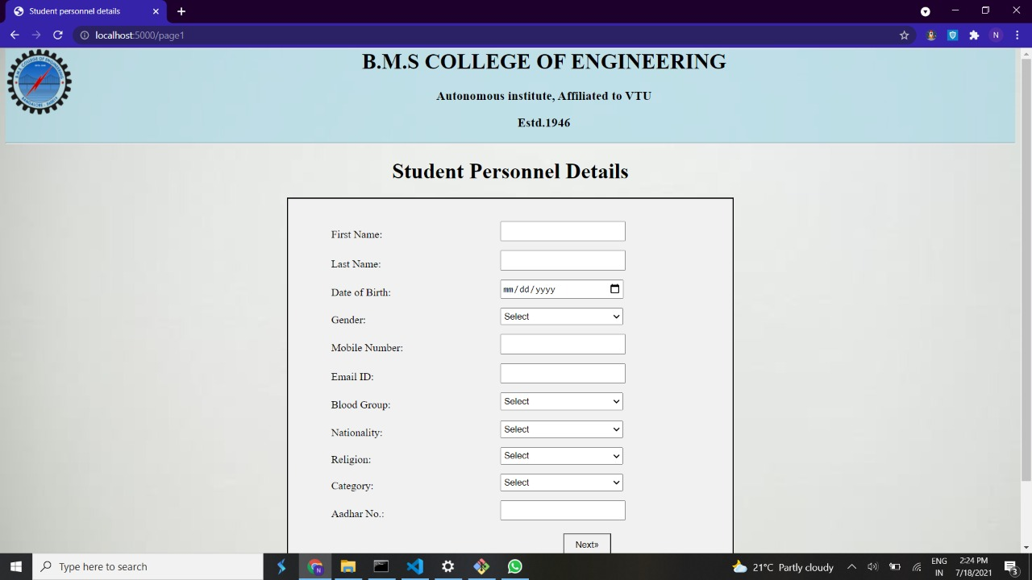
STUDENT PERSONAL DETAILS PAGE:

Slide 16
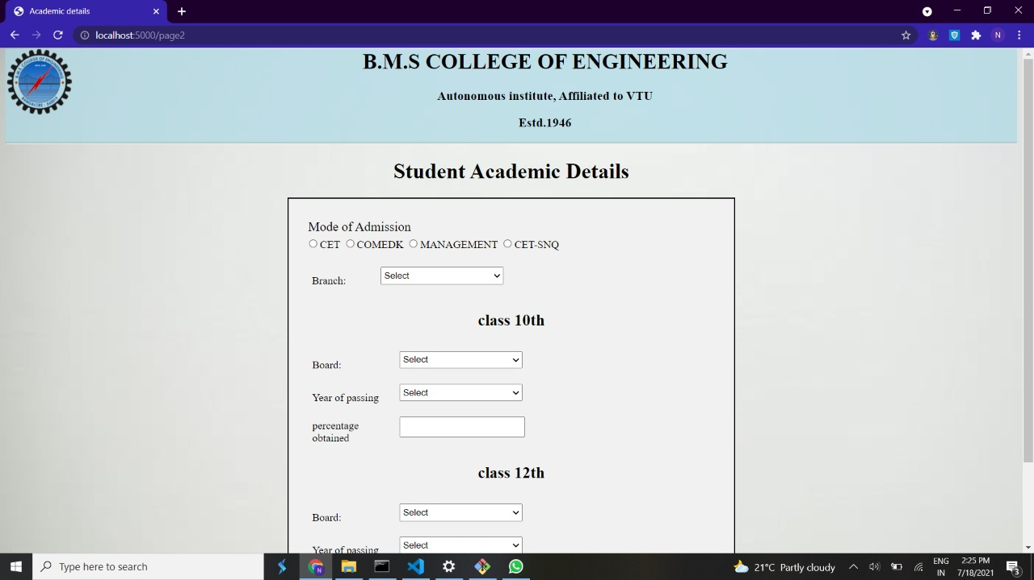
STUDENT ACADEMIC DETAILS PAGE:

Slide 17
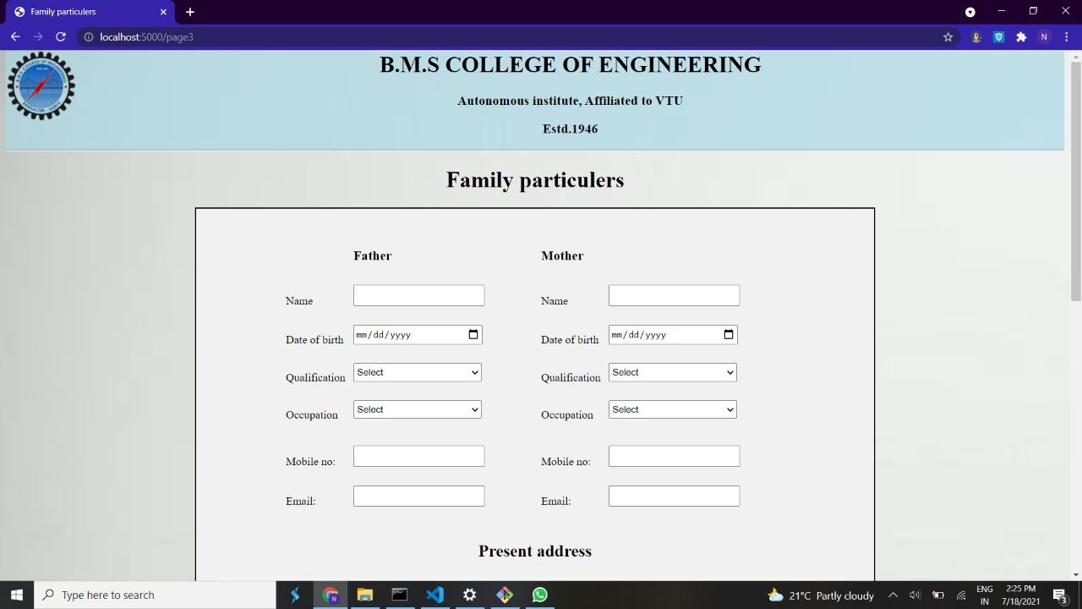
STUDENTS FAMILY DETAILS PAGE:

Slide 18
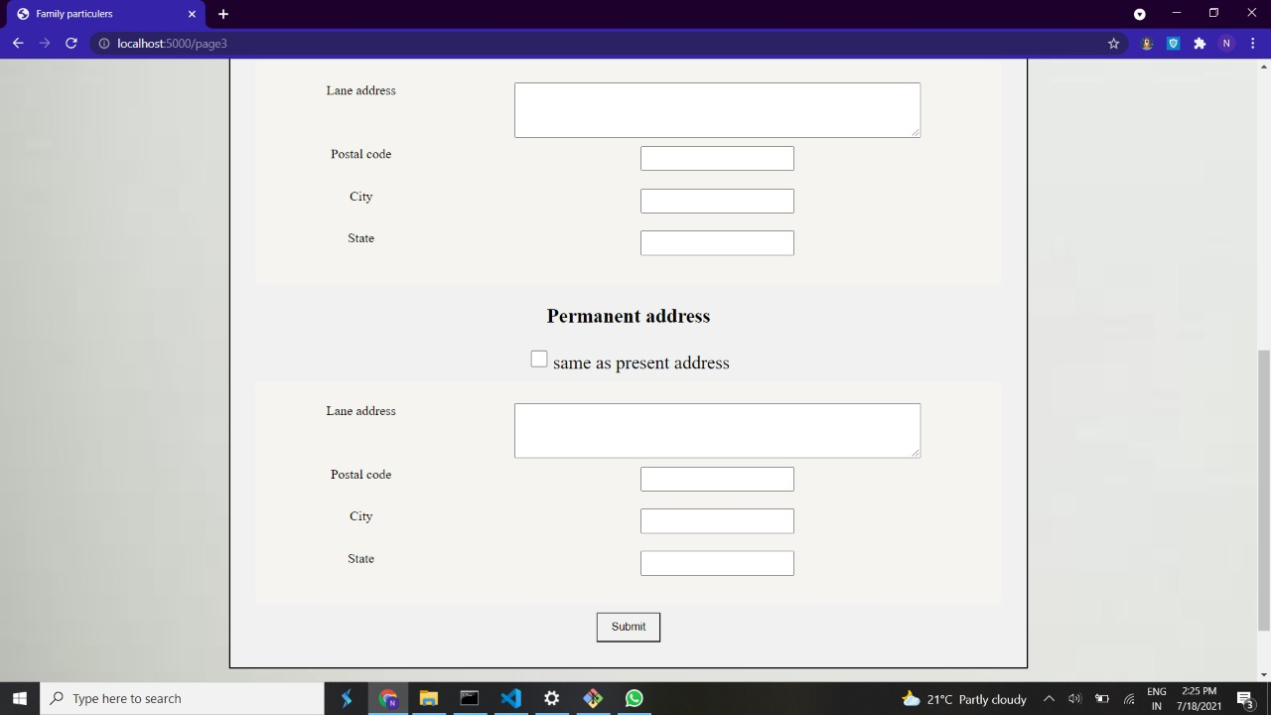

Slide 19
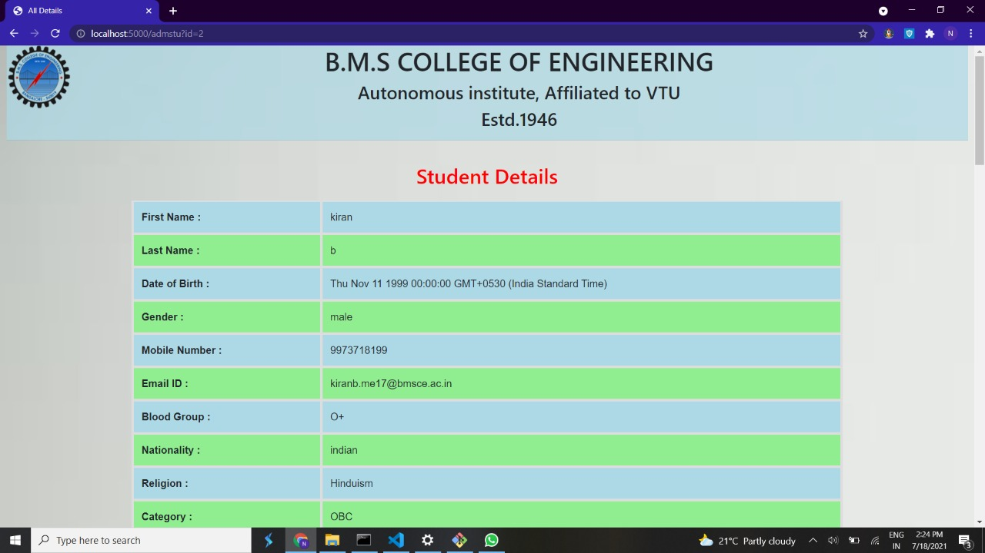
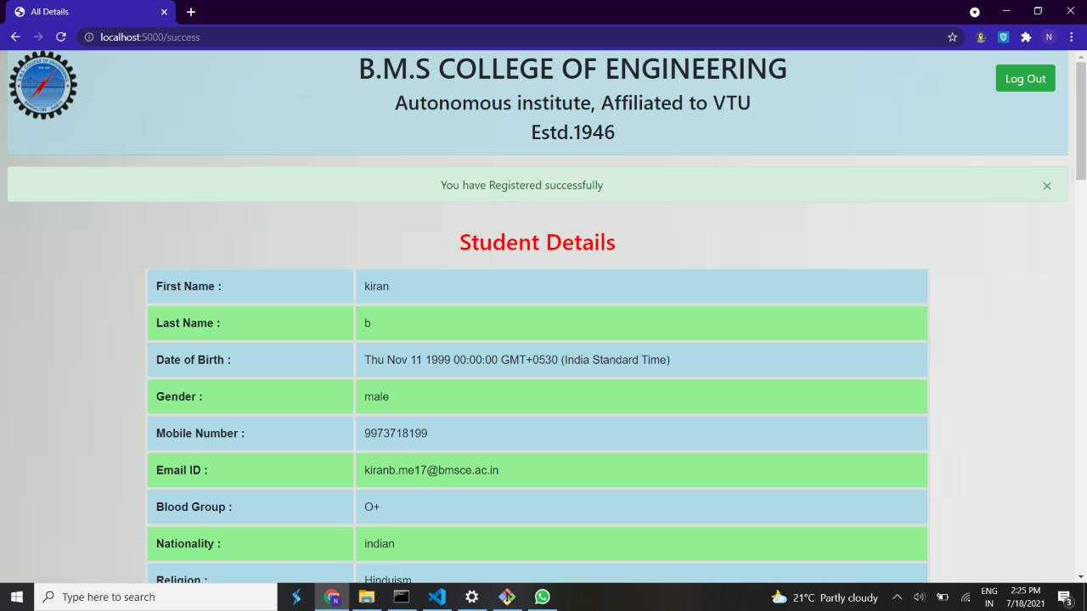
STUDENT DETAILS DISPLAY PAGE:

Slide 20
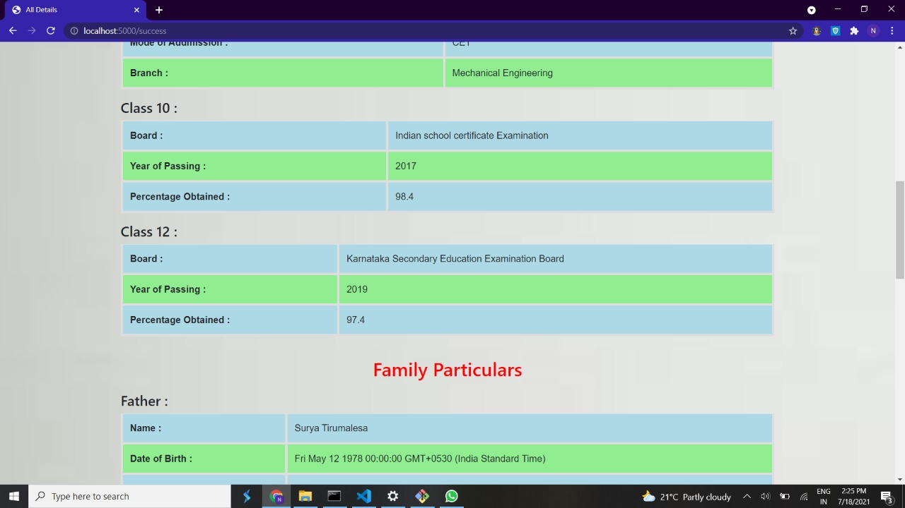

Slide 21
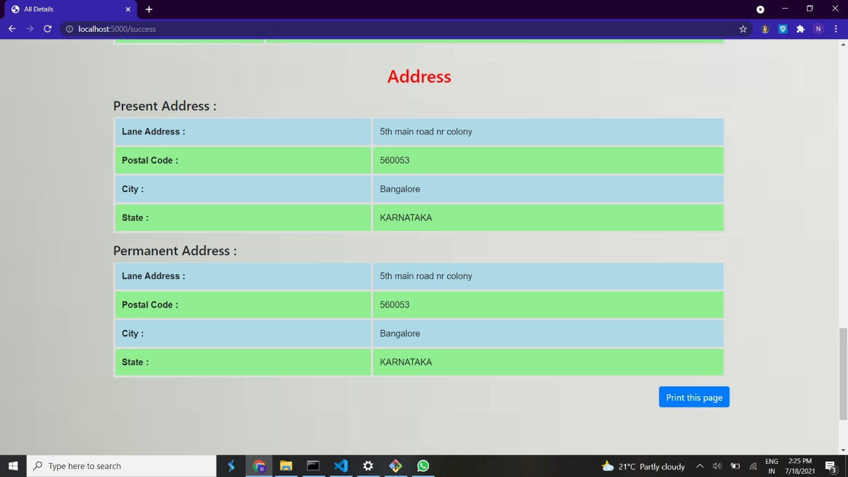

Slide 22
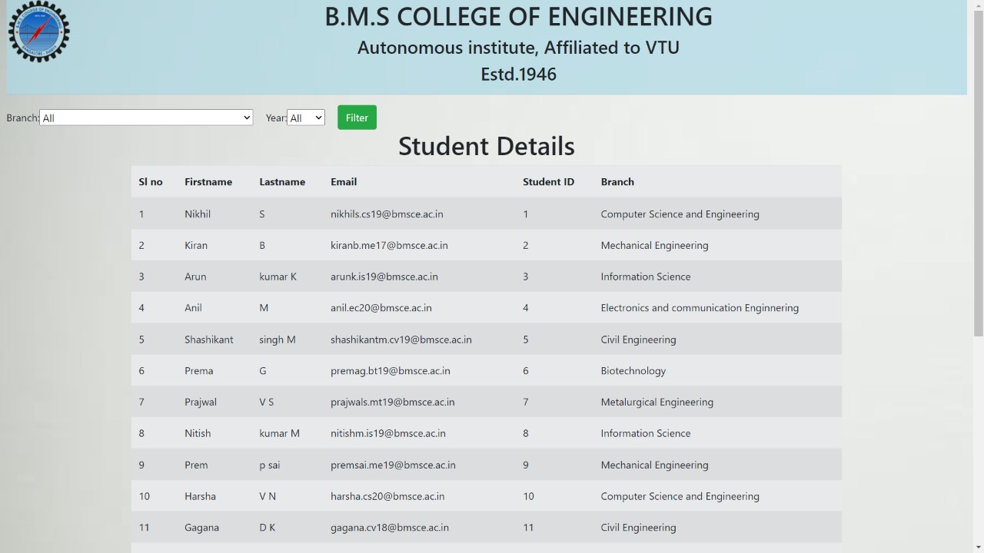
ADMIN PAGE:

Slide 23
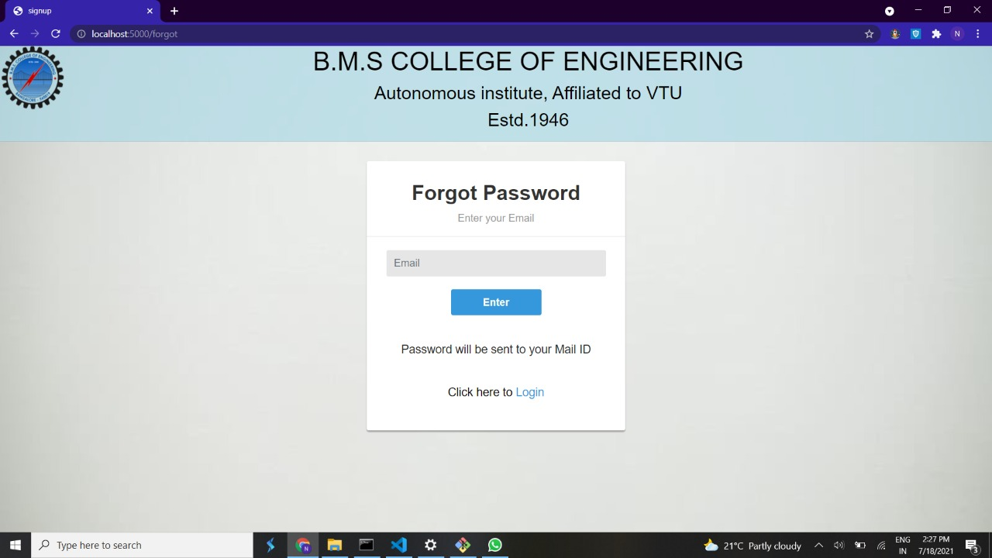
FORGOT PASSWORD PAGE:

Slide 24
CONCLUSION:
This project on “STUDENT DETAILS PORTAL” helps the students to fill their details including personal, academic and family from the place outside the college also.
This is also useful for the college admission team to collect their details and they can store and update their details if necessary.
The college admission team can filter the students list which they obtained by year and also by branch wise.

Slide 25
FUTURE ENHANCEMENT:
IN FUTURE, ALL THINGS MAY GO ONLINE AND THIS CAN BE BENIFITTED FOR THE COLLEGE AS WELL AS FOR THE STUDENTS IN EASILY FILLING THE DETAILS ONLINE AT ANY PLACE.
EVEN IN CASE IF STUDENT HAS FORGOTTED SOMETHING OR ENTERED WRONGLY CAN BE EASILY UPDATED.

Slide 26

REFERENCES:
1. https://www.tutorialspoint.com/nodejs/nodejs_express_framework.htm.
2. https://www.w3schools.com/nodejs/nodejs_mysql.asp.
3. https://youtu.be/JnvKXcSI7yk.
4. https://expressjs.com/.
5. https://stackoverflow.com/.

Slide 27


